Slide 1
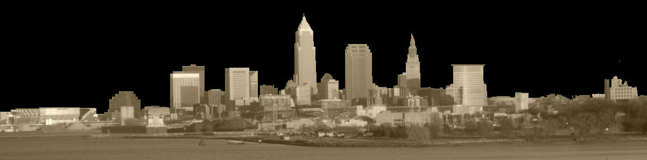
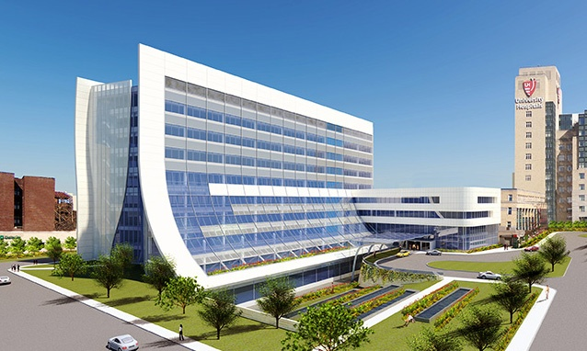
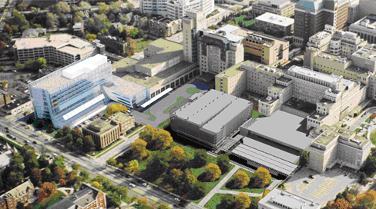
A.E. Senior Thesis 2009
Daniel C. Myers STRUCTURAL OPTION
A.E. Senior Thesis • April 13, 2009
Seismic Design: A Lateral Systems Investigation and Redesign
The University Hospitals Case Medical Center Cancer Hospital
Cleveland, Ohio
RESEARCH
INVESTIGATION
DESIGN

Slide 2
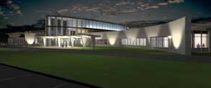
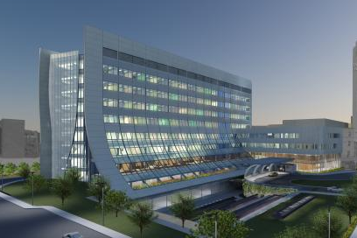
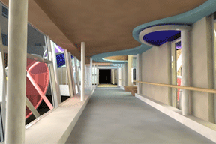
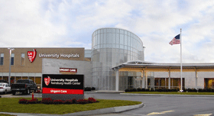
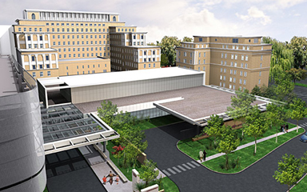
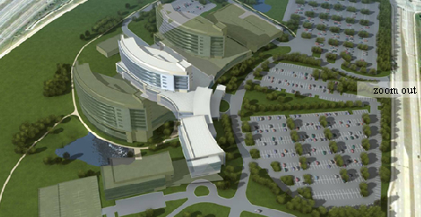
Vision 2010
University Hospitals
Vision 2010
UHCMC Campus
Rainbow NICU
Twinsburg
Cancer Hospital
Neonatal Intensive Care Unit
Center for Emergency Medicine
Ahuja Medical Center
Cardiovascular Facilities
UH Emergency
Medicine
Ahuja MC
RESEARCH
INVESTIGATION
DESIGN

Slide 3
overview
Problem:
Current Vision 2010 plan provides service to primarily the east coast
Solution:
Develop a design for west coast service while adhering to Vision 2010 restraints
Gain an understanding of the seismic design of irregular shaped buildings
RESEARCH
INVESTIGATION
DESIGN

Slide 4
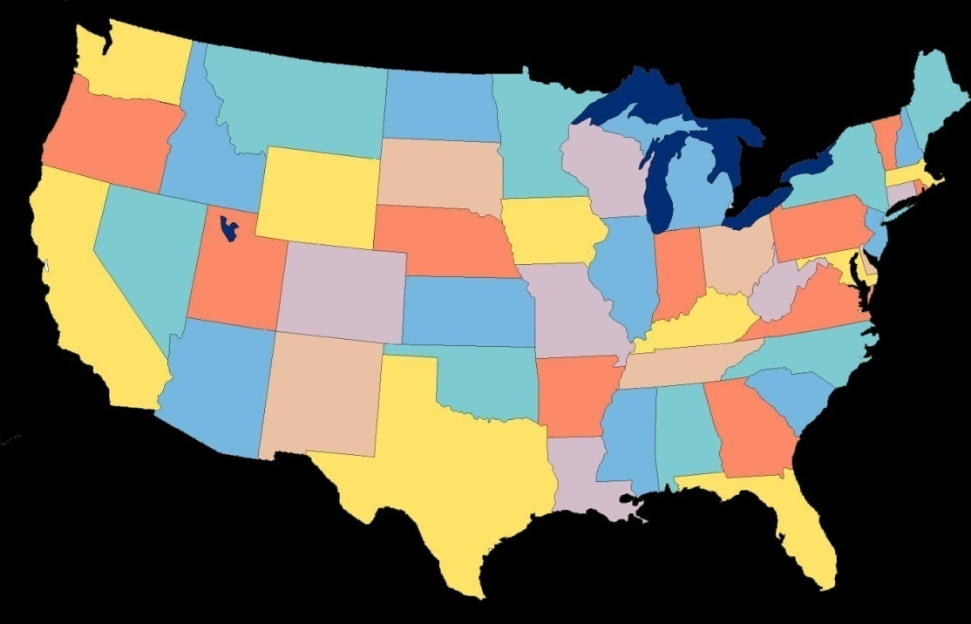
OVERVIEW
Goals:
Investigate 3 seismic design solutions for the existing design in San Diego, CA
  Strengthening of Existing Structure
  Use of a seismic isolation joint
  Addition of concrete shear wall core
Select and design the optimal system
Adhere to Vision 2010 constraints
  Limit redesign
  Meet current time schedule
  Low cost increase
Cleveland, OH
Wind Controlled
Category A
San Diego, CA
Seismic Controlled
Category D
RESEARCH
INVESTIGATION
DESIGN

Slide 5
overview
Topics Presented
Building Background
Lateral Systems Investigation
Redesign of Existing System
Building Envelope Redesign
Schedule and Cost Analysis
RESEARCH
INVESTIGATION
DESIGN

Slide 6
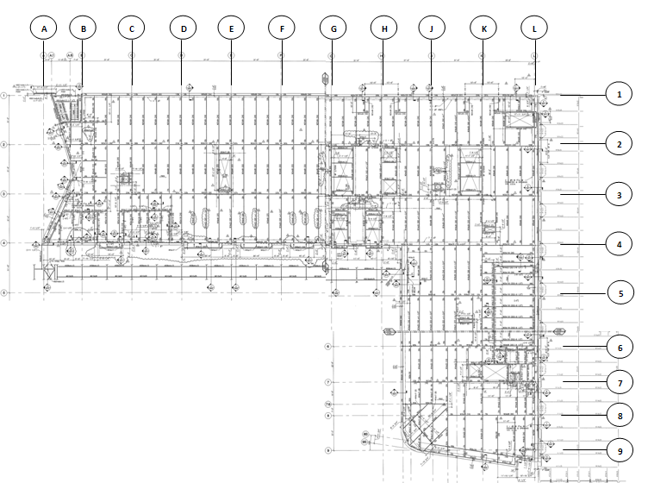
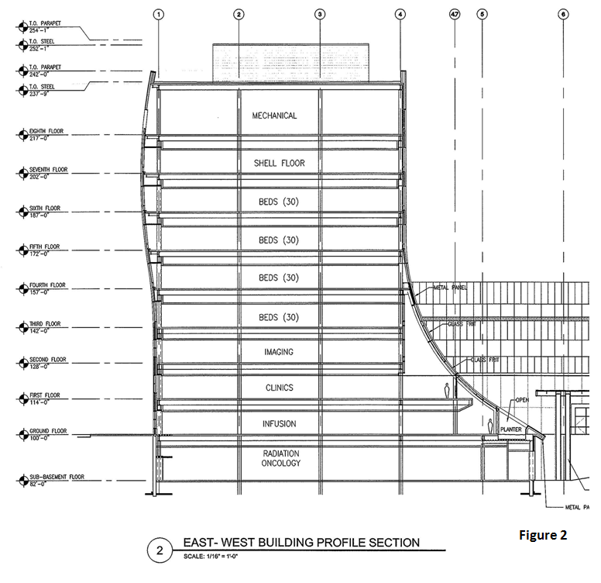
Building background
Architecture
31’-6” modular bays “Universal Grid”
9 above grade stories
172’-1” in height
14’-0” to 15’-0” high levels
Research and imaging on lower floors
Patient rooms in upper tower
RESEARCH
INVESTIGATION
DESIGN

Slide 7
Building background
Existing Structure
Foundations: 30”- 60” dia. piers / caissons
Framing: composite steel beam / girders
  3-1/2” and 5-1/2” composite deck
  W14 columns
  Typical W14x22 beams / W24x68 girders
Roof System: Sloped Composite Roof Deck
RESEARCH
INVESTIGATION
DESIGN

Slide 8
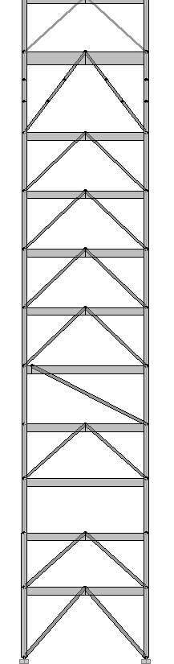
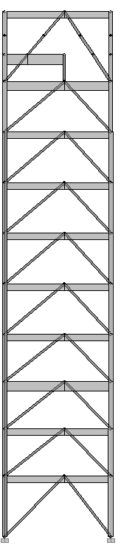
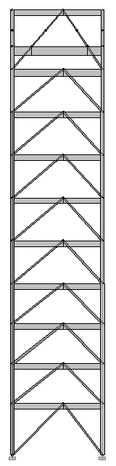
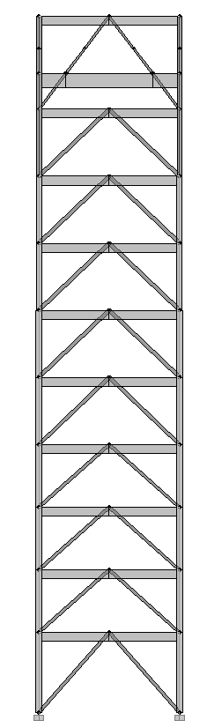
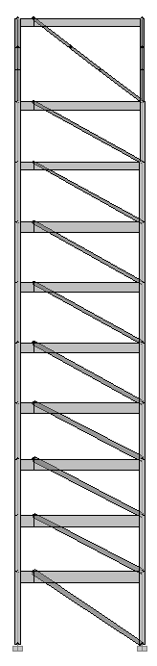
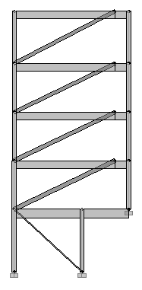
Building background
Existing Lateral System
6 Steel Braced Frames
Concentric and Eccentric Connections
HSS Diagonal Members
Near Elevator Core and Perimeter
Designed for Wind
RESEARCH
INVESTIGATION
DESIGN

Slide 9
Relocation
New Lateral Loading
Wind and Seismic forces found under new parameters
Methods used:
  Main Wind-Force Resisting Systems Method 2
  Equivalent Lateral Force Procedure
  Seismic forces exceeded Wind by 3 to 4 times
Wind effects will not be further investigated
RESEARCH
INVESTIGATION
DESIGN

Slide 10
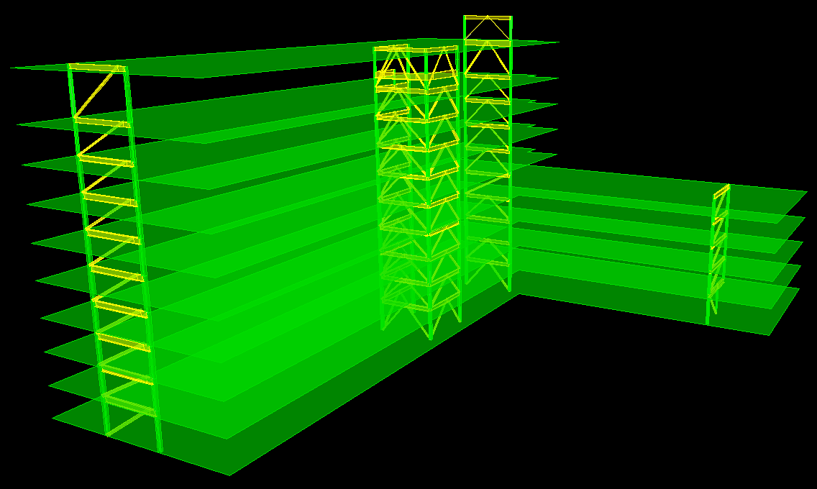
Relocation
ETABS Model
Existing lateral system modeled in ETABS
Loads manually calculated using ELF procedure
  Manual and ETABS values compared
ETABS values found to be more conservative
RESEARCH
INVESTIGATION
DESIGN

Slide 11
Structural Depth
Lateral System Investigation
Strength and Serviceability:
  Period
  Deflection
  Story Shear
  Member Force
  Torsion
  Structural Irregularity
Architectural Effect
RESEARCH
INVESTIGATION
DESIGN

Slide 12
Structural Depth
Strengthening Existing Structure
Positive:
  Strong resistance to torsion; Axmax = 1.1
  Distributes forces well around inherent corner
  Fundamental period reasonable
Negative:
  Deflections @ critical points extremely large
  Floor to floor drift exceeds limit by approx. 3x
  Additional size and quantity of frames req’d
  All frames need to be designed as special
RESEARCH
INVESTIGATION
DESIGN

Slide 13
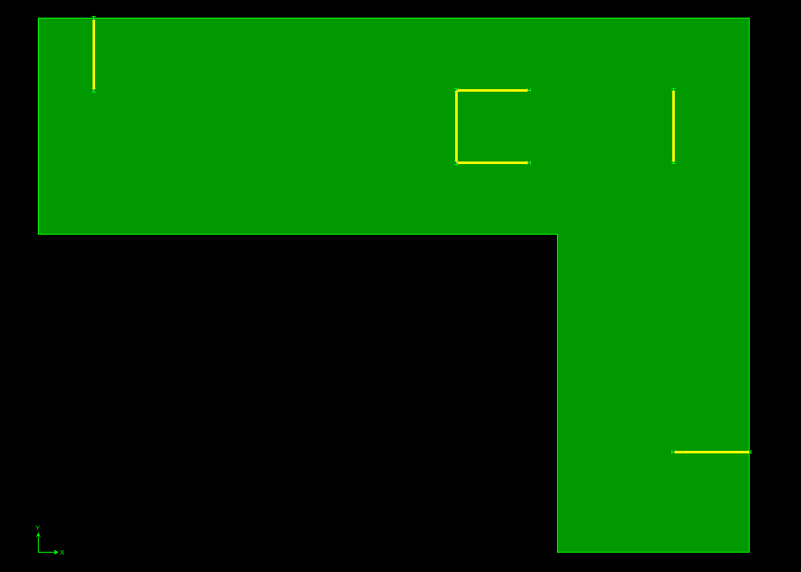
Structural Depth
Seismic Isolation Joint
Positive:
  Even stronger resistance to torsion; Axmax = 1.0
  10% reduction in drift and deflection
  No irregularity
Negative:
  Continues to greatly exceed drift limits by 2.5x
  Exhibits similar downfalls compared to existing
  Torsion decrease minimally affected lateral system
  Additional frames required in tower and extension
RESEARCH
INVESTIGATION
DESIGN

Slide 14
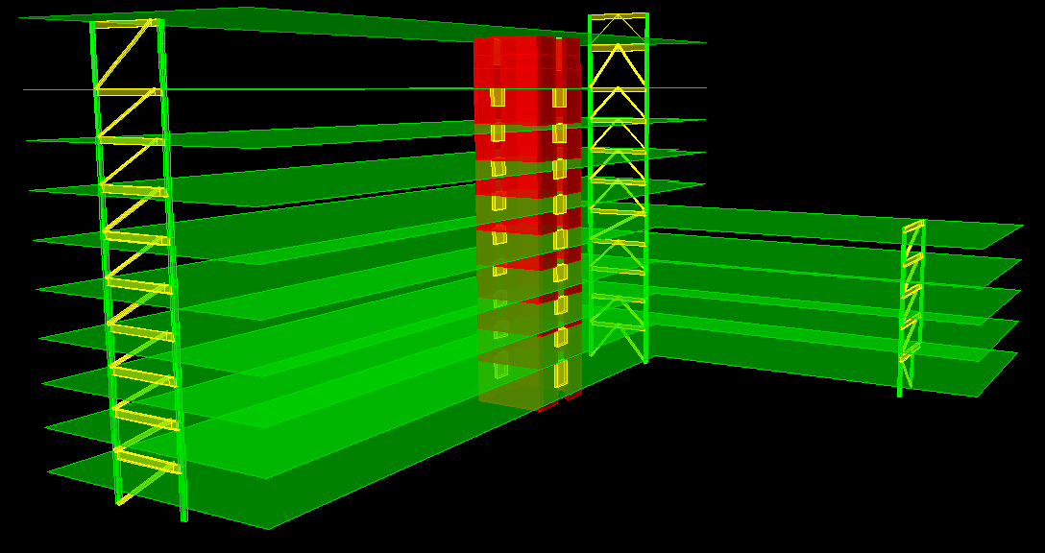
Structural Depth
Concrete Shear Wall Core
Positive:
  Dramatic decrease in drift, deflection, and period
  Shear walls effectively collect sizeable amount of load
  Loads within reasonable design values
  Works well with existing architecture
Negative:
  Significant torsion exists in building; Axmax = 3.0
  Torsional irregularity type 1b
  Load collection by lateral elements not evenly distributed
RESEARCH
INVESTIGATION
DESIGN

Slide 15
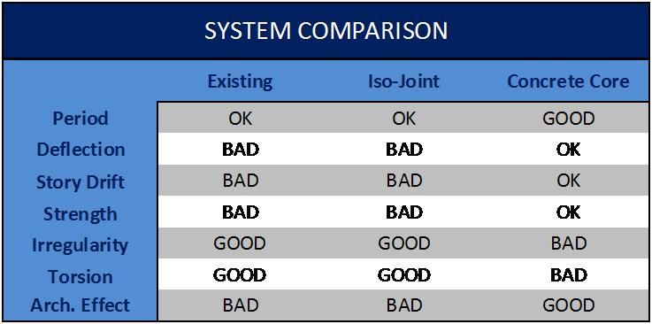
Structural Depth
RESEARCH
INVESTIGATION
DESIGN

Slide 16
Structural Depth
New Lateral System Design
Steel Braced Frames
  Critical Steel Connection
Concrete Shear Wall Core
Foundations
RESEARCH
INVESTIGATION
DESIGN

Slide 17
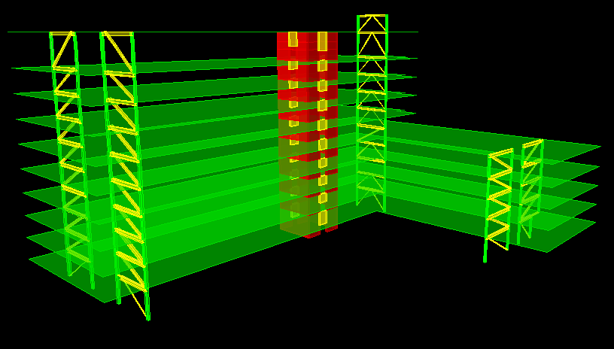
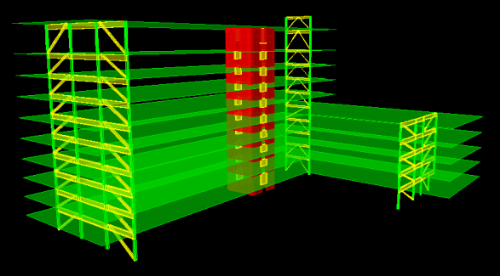
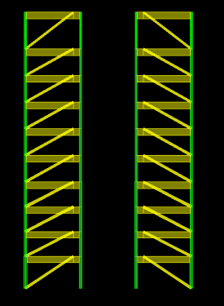
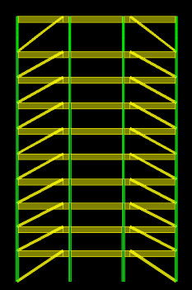
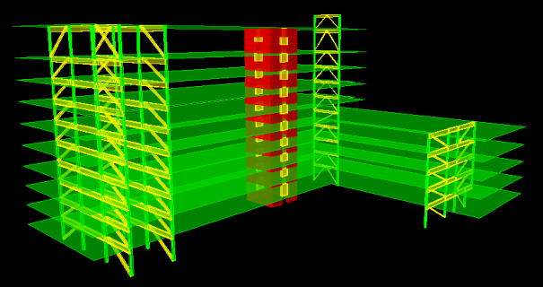
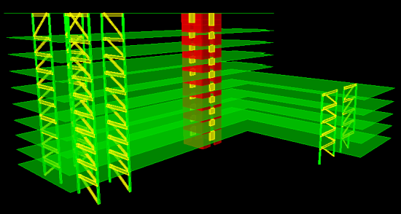

Structural Depth
CRITICAL DISPLACEMENT POINTS
Steel Braced Frame Design
Pt. 51
Pt. 61
Designed in accordance with:
  ASCE 7-05
  AISC Steel Construction Manual, 2005
  Initially designed based on deflection
    Critical point 51
    Deflection controlled
Used lower R value of 6 for special concrete shear walls
Accidental torsion factor of 1.0 assumed for design
Symmetrical Perimeter
Added Moment Frame
Pt. 60
Pt. 53
Double Frame
Final Design
RESEARCH
INVESTIGATION
DESIGN

Slide 18
Structural Depth
Symmetrical Perimeter
Added Moment Frame
Double Frame
Final Design
RESEARCH
INVESTIGATION
DESIGN

Slide 19
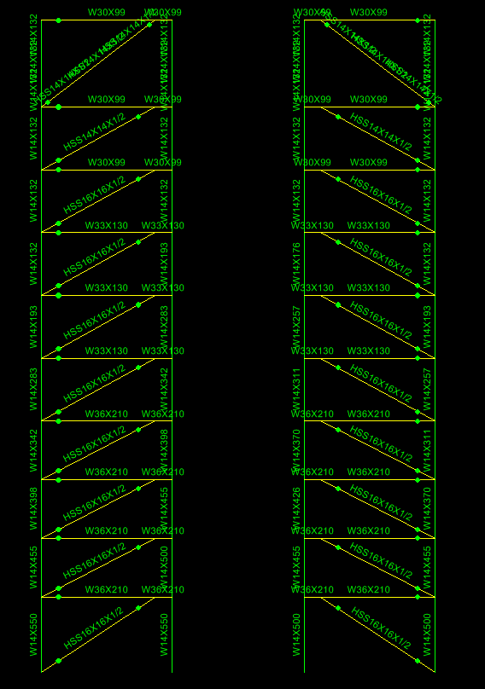
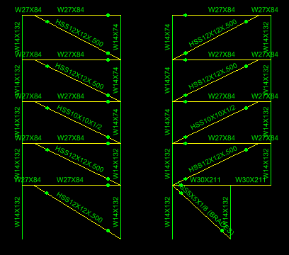
Structural Depth
Final Braced Frame Design
Frames @ B and C:
  Typical HSS16x16x1/2 braces on lower levels
  Typical HSS14x14x1/2 braces on upper levels
  W14 members preserved w/ W30 and W33 beams
  Frames @ 7
    Typical HSS12x12x3/8 braces
    W14 member preserved w/ W27 beams
Frames @ 7
Frames @ B and C
RESEARCH
INVESTIGATION
DESIGN

Slide 20

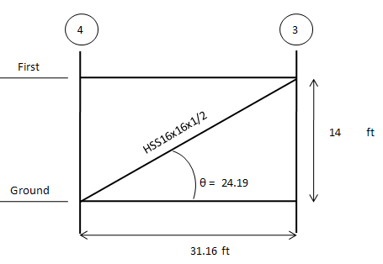
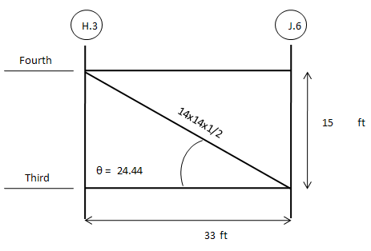
Structural Depth
Strength Check
Strength:
  Redundancy Factor of 1.3 applied
  ASCE 7-05 Load Combination 5 controlled design
  D+1.0E+L+.2S
        Slenderness:
  KL/r ≤ 200
    Width-to-Thickness:
    b/t ≤ 1.4√E/Fy
North/South Direction
East/West Direction
RESEARCH
INVESTIGATION
DESIGN

Slide 21
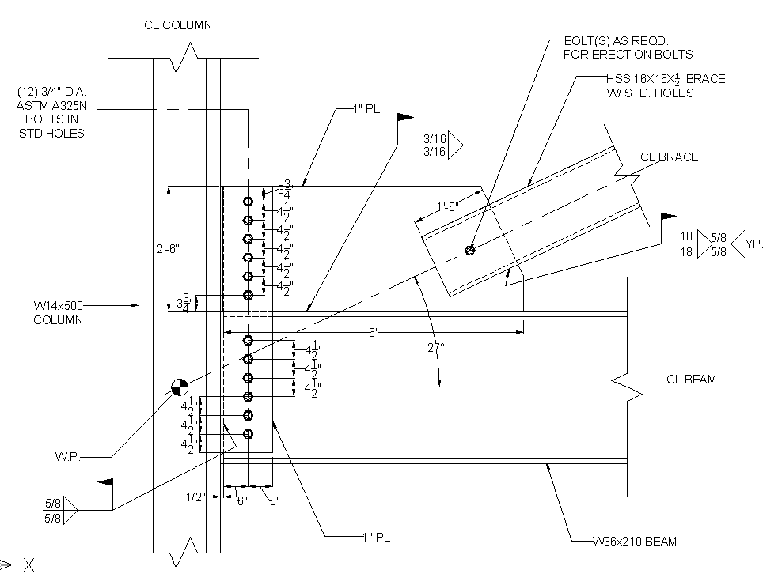

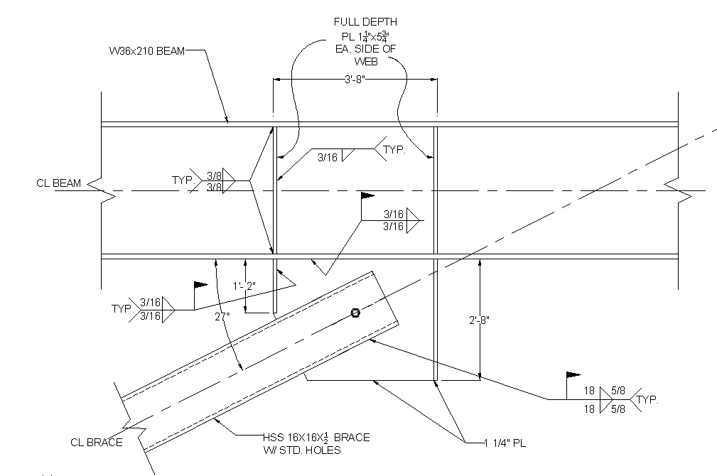
Structural Depth
Critical Steel Connection Design
Master’s Requirement
Critical connections selected @ Frame C on Ground Floor
  Connection designed in accordance with:
            ASCE 7-05
            AISC Seismic Design Manual
    Ordinary Concentric Connection
    Special Eccentric Connection
Ordinary Concentric
Connection
Eccentric Connection
RESEARCH
INVESTIGATION
DESIGN

Slide 22
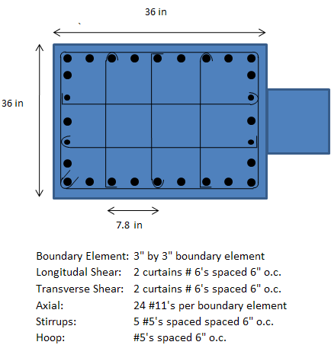
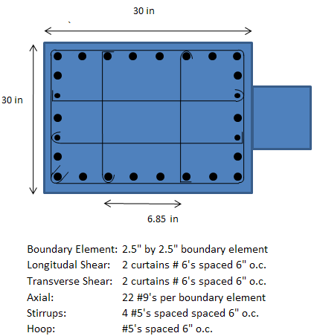
Structural Depth
Concrete Shear Wall Design
Shear Wall @ G and H
Shear Wall @ 2 and 3
Designed in accordance with:
  ASCE 7-05
  ACI 318-05
        Critical section selected at @ Shear Wall G and H
        Boundary Elements used to accommodate special seismic design provisions:
          2-1/2’x2-1/2’ boundary element @ Shear Wall G and H
          3’x3’ boundary element @ Shear Wall 2 and 3
RESEARCH
INVESTIGATION
DESIGN

Slide 23
Structural Depth
Coupling Beam Design
Located on all levels @ Shear Wall 2 and 3
        Sizes vary with story height between 82”, 94”, and 130”
        Width of coupling beam 18” in accordance with walls
        Diagonal reinforcement has been used on all coupling beams
RESEARCH
INVESTIGATION
DESIGN

Slide 24
Structural Depth
Foundations
Gravity loads determined through column takedowns
        Maximum downward and uplift force calculated
        Uplift capacity assumed to be provided only by friction
        50’ caissons needed to gain req’d friction strength
        Caisson diameters range from 4’ to 9’
RESEARCH
INVESTIGATION
DESIGN

Slide 25
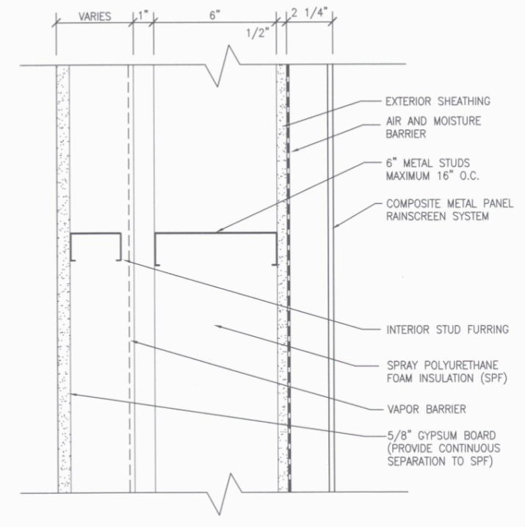
Building Envelope Breadth
Building Envelope Redesign
Thermal and Moisture Investigation
Load Resistance Design
RESEARCH
INVESTIGATION
DESIGN

Slide 26
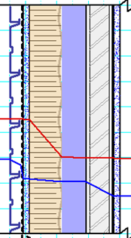
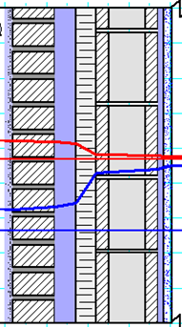
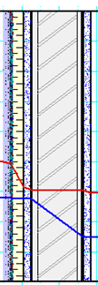
Building Envelope Breadth
Thermal and Moisture Analysis
Existing Wall System
  Works well with current architecture
  Slightly conservative
  Relies heavily on maintenance
        Cavity Wall
          Adequate thermal resistance
          Most effective moisture penetration resistance
          Varies most from original architecture
        EIFS
          Greatly reduces wall thickness
          More efficient thermal resistance value
          Not effective when penetrated
Barrier Wall
Cavity Wall
EIFS System
RESEARCH
INVESTIGATION
DESIGN

Slide 27
Building Envelope Breadth
Load Resistance Design
Lateral Force Resistance
  2 plies of 1/4” Laminated Glass Units
  Fully tempered
        Seismic Drift Resistance
          3/8” clearance on all sides
        Blast Resistance Capacity (increase to 5/16”)
          100lb explosive at 50’
          500lb explosive at 100’
RESEARCH
INVESTIGATION
DESIGN

Slide 28
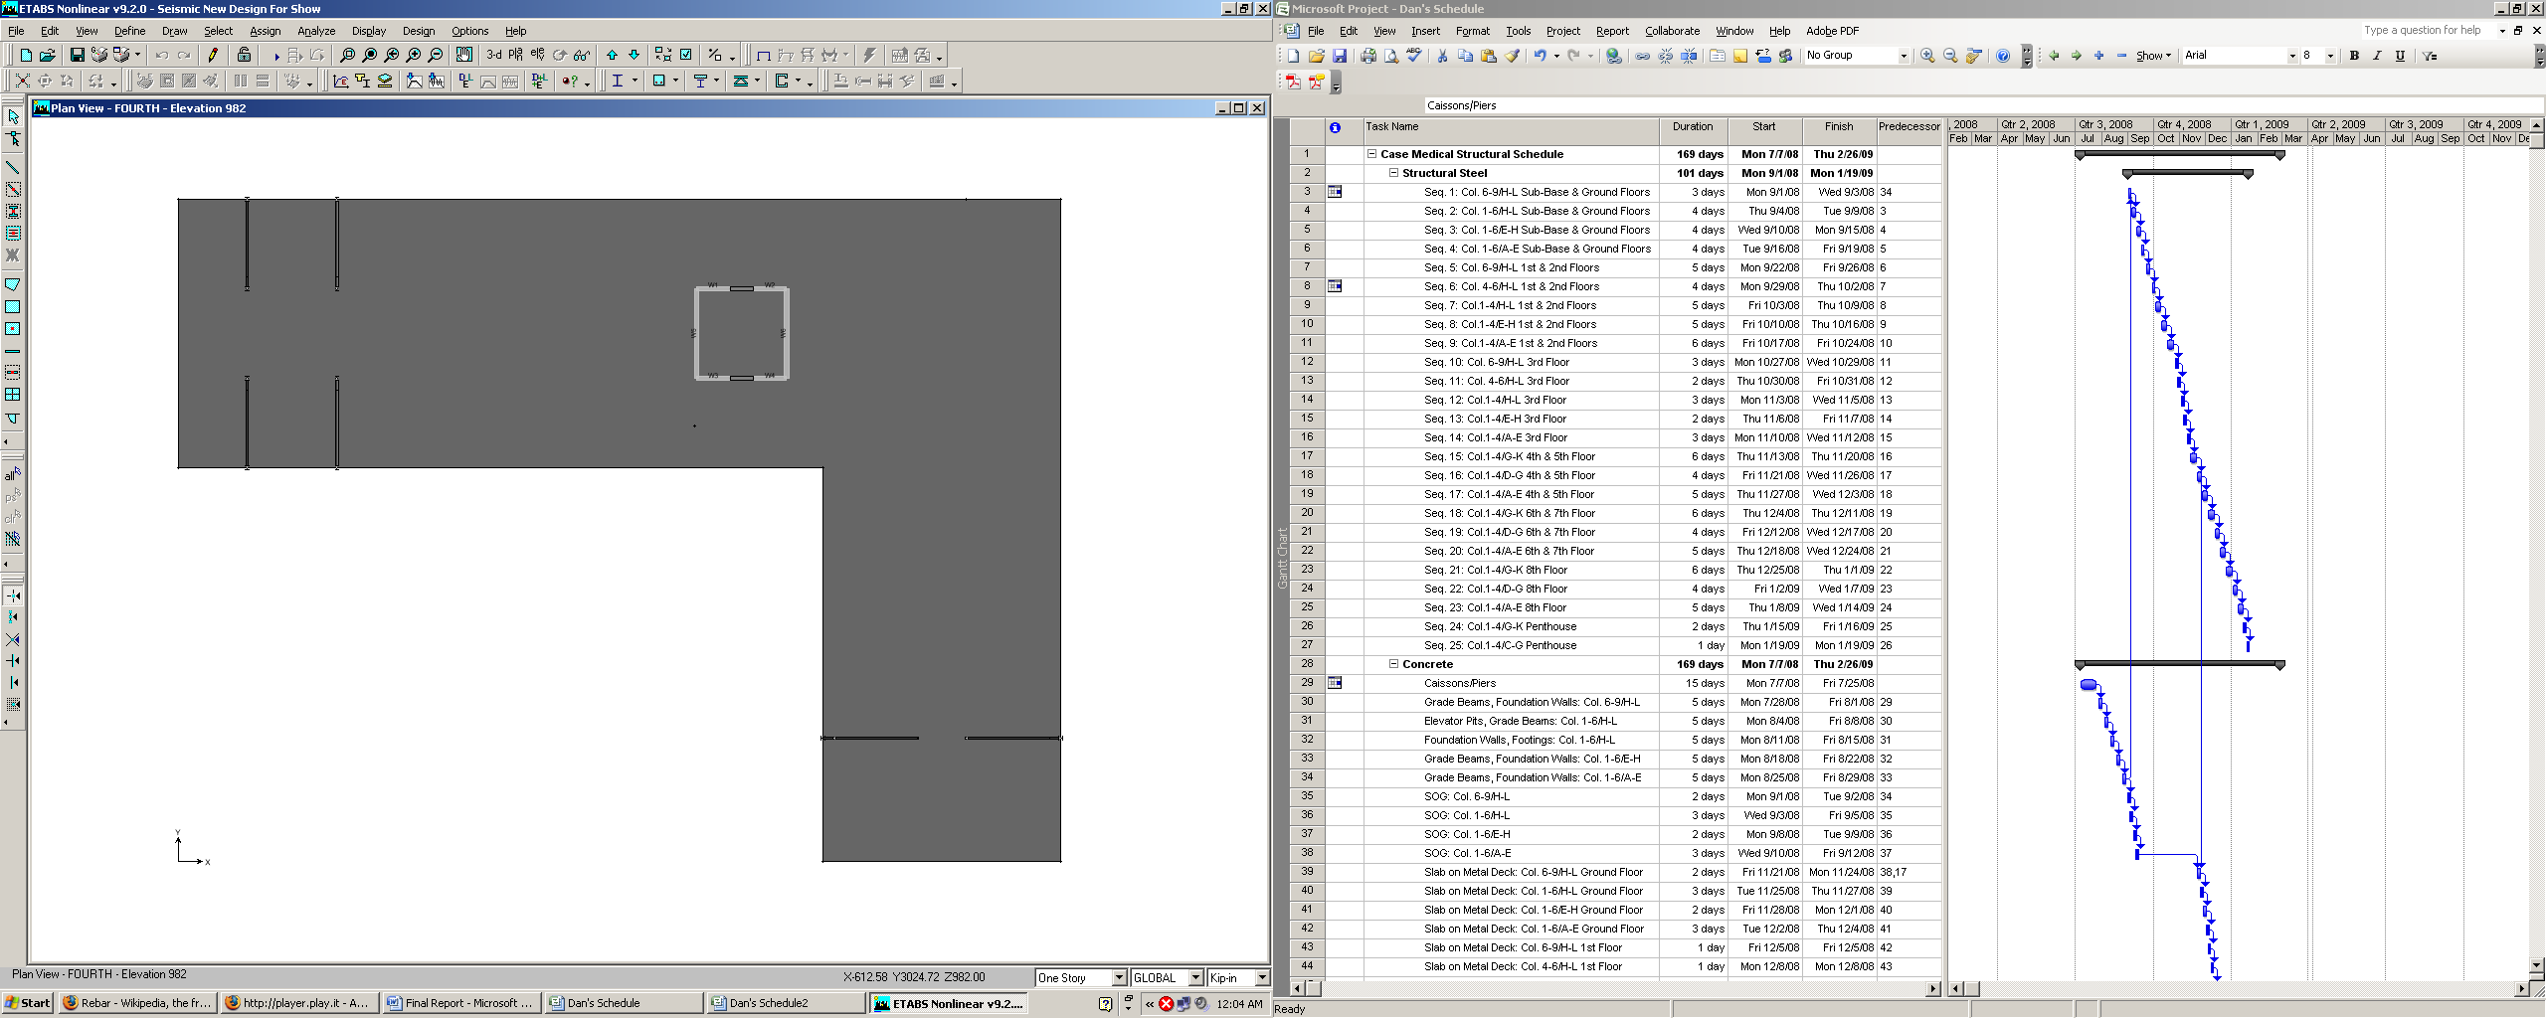
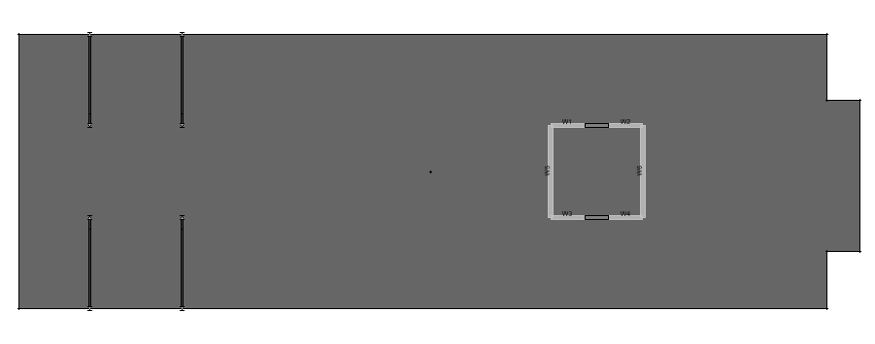
Schedule and Cost Analysis Breadth
Existing Schedule
Ground / Sub Floor
1st Level – 3rd Level
4
3
2
5
4
3
July 2008 – December 2010
        179 day estimated structure construction time
        Use of single crane
        Sequenced construction using 3 to 5 zones
2
1
1
4th Level - Roof
3
2
1
RESEARCH
INVESTIGATION
DESIGN

Slide 29
Schedule and Cost Analysis Breadth
Revised Schedule
Crane 1
New schedule must accommodate 50 additional days for shear walls
        Proposed use of 2nd crane for 17 days
        Structural construction time decreased to 154 days
        Adds additional time to meet Vision 2010 deadline
3
2
1
2
Crane 2
1
RESEARCH
INVESTIGATION
DESIGN

Slide 30
Schedule and Cost Analysis Breadth
Cost Analysis
Estimated cost of existing lateral system:
  $1,553,483.00
        Estimated cost of new lateral system:
        $2,335,333.00
        Increase in cost compared to $1 billion Vision 2010 Budget
RESEARCH
INVESTIGATION
DESIGN

Slide 31
A.E. Senior Thesis 2009
Conclusion
Seismic design solutions investigated
Efficient new design for San Diego, CA developed
        Construction time decreased
        Low cost increase
        Vision 2010 constraints met
RESEARCH
INVESTIGATION
DESIGN

Slide 32
A.E. Senior Thesis 2009
Acknowledgements
My A.E. Classmates for all the help and support over the past five years.
The Pennsylvania University A.E. Faculty
Dr. Memari for being a great personal thesis mentor.
I would like to thank Cannon Design for supplying all plans and building information requested in a timely manner.
RESEARCH
INVESTIGATION
DESIGN

Slide 33
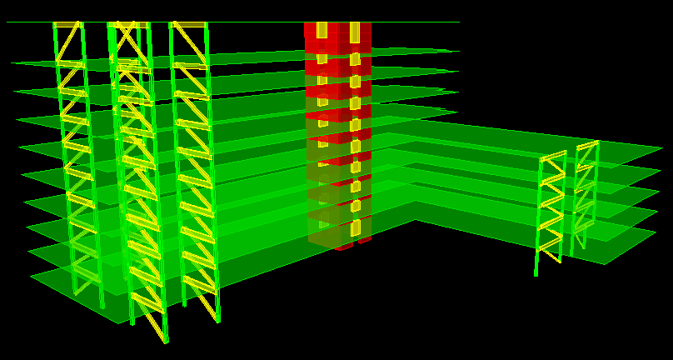
A.E. Senior Thesis 2009
Questions?
RESEARCH
INVESTIGATION
DESIGN

